Slide 1
Welcome to ENTR 451
Special Topics in ENTR: Barca

Slide 2
Rundown of the Day
Organization
Individuals
Barca organization
Choosing a method of grading
Why Barcelona
Creative Class
Overview of the Marketing Process
Overview of Segmentation
Overview of Targeting

Slide 3
Individuals – La Linia Barca 2017
Line up in height order, shortest to tallest
Remember your number, as that will be important for the remainder of the trip
Whenever we go somewhere as a group, know the number (person) in front of you and the person behind you

Slide 4
La Linia Barca 2017 Organization
WHAT VALUES SHOULD WE STAND BY?
How do these compare with the American values you mentioned yesterday?
WHAT IS OUR VISION STATEMENT?
WHAT IS OUR MISSION STATEMENT?
The mission statement is the organization’s purpose; what it wants to accomplish in the larger environment
Who? What? Why? When? Where? NOT How.
We are here to create a marketing company that specializes in Barcelona start-ups
Each of you is an account manager for the organization
You have been becoming familiar with the organization over the past few months
TELL ME ABOUT YOUR ORGANIZATIONS

Slide 5
Methods of Grading
- Company Evaluation (5-15%)
- Class Participation (5-15%)
- Homework -3 Assignments (5-15%)
- Quizzes - 3 Online quizzes (5-15%)
- Startup Operations Manual (15-30%)
- Presentation (15-30%)
Talk with another Even or Odd Number about what you want to do

Slide 6
So, why Barcelona?
The Rise of the Creative Class by Richard Florida (2002)
Regional economic advantages are no longer based on raw materials or competition for companies
Creativity has become the wellspring of economic growth
Regions must develop, attract and retain talented and creative people who generate innovations, develop technology intensive industries, and power economic growth

Slide 7
So, why Barcelona?
3 T’s and 1 C of Economic Growth –
Talent (% of residents with a bachelors degree)
Tolerance (% of population that is foreign-born)
Technology (a region’s share of national employment in high-tech industries relative to the region’s overall share of national employment)
Creativity (a city region’s share of the nation’s employment in artistic and creative occupations relative to the region’s share of the nation’s population)
Barcelona is growing in all of these areas

Slide 8
Marketing Backbone
Segmentation
Targeting
Positioning
Differentiation
Price
Promotion
Place
Product

Slide 9
Customer-Driven Marketing Strategy
Notes:
Companies today recognize that they cannot appeal to all buyers in the marketplace—or at least not to all buyers in the same way. They must design customer-driven marketing strategies that build the right relationships with the right customers.
Thus, most companies have moved away from mass marketing and toward target marketing: identifying market segments, selecting one or more of them, and developing products and marketing programs tailored to each.
Figure 7.1 shows the four major steps in designing a customer-driven marketing strategy:
Segmentation
Targeting
Differentiation
Positioning
We will discuss each of these steps in turn.

Slide 10
Market Segmentation
Market segmentation requires dividing a market into smaller segments with distinct needs, characteristics, or behaviors that might require separate marketing strategies or mixes.
Notes:
Buyers in any market differ in their wants, resources, locations, buying attitudes, and buying practices. Through market segmentation, companies divide large, heterogeneous markets into smaller segments that can be reached more efficiently and effectively with products and services that match their unique needs.

Slide 11
Market Segmentation
Segmenting consumer markets
Segmenting business markets
Segmenting international markets
Requirements for effective segmentation
Notes:
In Learning Objective 2, we will discuss four important segmentation topics: segmenting consumer markets, segmenting business markets, segmenting international markets, and the requirements for effective segmentation.

Slide 12
Market Segmentation
Segmenting Consumer Markets
Geographic segmentation
Demographic segmentation
Psychographic segmentation
Behavioral segmentation
Notes:
There is no single way to segment a market. A marketer has to try different segmentation variables, alone and in combination, to find the best way to view market structure. This visual outlines variables shown in Table 7.1 that might be used in segmenting consumer markets.

Slide 13
Market Segmentation
Segmenting Consumer Markets
Geographic segmentation divides the market into different geographical units such as nations, regions, states, counties, cities, or even neighborhoods.
Notes:
A company may decide to operate in one or a few geographical areas or operate in all areas but pay attention to geographical differences in needs and wants.
Many companies today are localizing their products, advertising, promotion, and sales efforts to fit the needs of individual regions, cities, and neighborhoods.
For example, Domino’s Pizza, the nation’s largest pizza delivery chain, keeps its marketing and customer focus decidedly local. Customers anywhere in the nation can use the online platform or smartphone app to track down local coupon offers, locate the nearest store with a GPS store locator, and quickly receive a freshly-made pizza. They can even use Domino’s Pizza Tracker to follow their pies locally from store to door.

Slide 14
Market Segmentation
Segmenting Consumer Markets
Demographic segmentation divides the market into segments based on variables such as age, life-cycle stage, gender, income, occupation, education, religion, ethnicity, and generation.
Notes:
Demographic factors are the most popular bases for segmenting customer groups. One reason is that consumer needs, wants, and usage rates often vary closely with demographic variables. Demographic variables are easier to measure than most other types of variables.
Even when marketers first define segments using other bases, such as benefits sought or behavior, they must know a segment’s demographic characteristics to assess the size of the target market and reach it efficiently.

Slide 15
Market Segmentation
Segmenting Consumer Markets
Age and life-cycle stage segmentation divides a market into different age and life-cycle groups.
Gender segmentation divides a market into different segments based on gender.
Income segmentation divides a market into different income segments.
Notes:
Consumer needs and wants change with age. Some companies offer different products or use different marketing approaches for different age and life-cycle groups. Other companies offer brands that target specific age or life-stage groups. For example, Amazon targeted a younger tablet market for using the Kindle Fire tablet, introducing FreeTime Unlimited, a multimedia subscription service targeted toward 3- to 8-year-olds. Marketers must be careful to guard against stereotypes when using age and life-cycle segmentation.
Gender segmentation has long been used in clothing, cosmetics, toiletries, and magazines. For example, P&G was among the first to use gender segmentation with Secret, a brand specially formulated for a woman’s chemistry, and packaged and advertised to reinforce the female image. More recently, the men’s personal care industry has exploded, and many cosmetics brands that previously catered mostly to women—like L’Oréal and Nivea—now successfully market men’s lines.
The marketers of products and services such as automobiles, clothing, cosmetics, financial services, and travel have long used income segmentation. Many companies target affluent consumers with luxury goods and convenience services. Other marketers use high-touch marketing programs to court the well-to-do.
Not all companies that use income segmentation target the affluent. For example, many retailers—such as the Dollar General, Family Dollar, and Dollar Tree store chains—successfully target low- and middle-income groups. The core market for such stores is represented by families with incomes under $30,000.

Slide 16
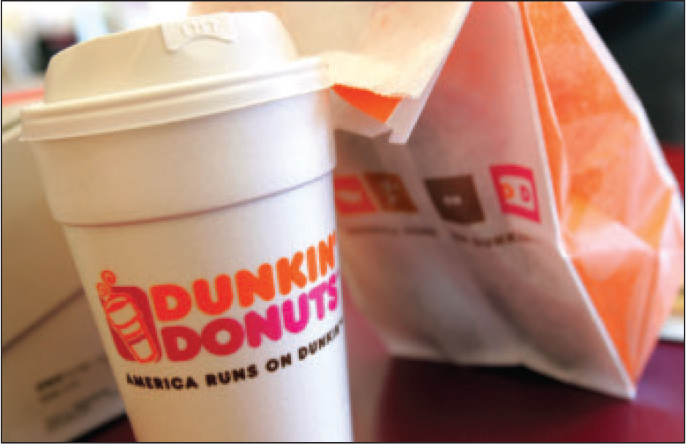
Market Segmentation
Segmenting Consumer Markets
Psychographic segmentation divides a market into different segments based on social class, lifestyle, or personality characteristics.
DUNKIN
Pic
Notes:
Psychographic segmentation: Dunkin’ Donuts successfully targets the “Dunkin’ tribe”—not the Starbucks coffee snob but the average Joe. Dunkin’ Donuts isn’t like Starbucks—it doesn’t want to be.”
People in the same demographic group can have very different psychographic characteristics.
In Chapter 5, we discussed how the products people buy reflect their lifestyles. Marketers also use personality variables to segment markets. For example, different soft drinks target different personalities. Mountain Dew projects a youthful, rebellious, adventurous personality whereas Coca-Cola Zero appeals to target personality types which are more mature, practical, and cerebral but good-humored. Its subtly humorous ads promise “Real Coca-Cola taste and zero calories.”

Slide 17
Market Segmentation
Segmenting Consumer Markets
Behavioral segmentation divides a market into segments based on consumer knowledge, attitudes, uses of a product, or responses to a product.
Notes:
Many marketers believe that behavior variables are the best starting point for building market segments.

Slide 18

Market Segmentation
Segmenting Consumer Markets
Behavioral Segmentation
Occasions
Benefits sought
User status
Usage rate
Loyalty status
Notes:
Benefit segmentation: Schwinn makes bikes for every benefit segment. For example, Schwinn’s urban bikes are “for riders who want a functional, durable, and stylish bike to commute or ride casually in urban areas.”
Occasions refer to when consumers get the idea to buy, actually make their purchase, or use the purchased item. Occasion segmentation can help firms build up product usage. Campbell’s advertises its soups more heavily in the cold winter months, and Home Depot runs special springtime promotions for lawn and gardens products. Other marketers prepare special offers and ads for holiday occasions or nontraditional occasions.
Benefits sought refers to finding the major benefits people look for in a product class, the kinds of people who look for each benefit, and the major brands that deliver each benefit.
Markets can be segmented by user status: nonusers, ex-users, potential users, first-time users, and regular users of a product. Marketers want to reinforce and retain regular users, attract targeted nonusers, and reinvigorate relationships with ex-users.
Markets can also be segmented by usage rate: light, medium, and heavy product users. Heavy users are often a small percentage of the market but account for a high percentage of total consumption. For instance, a recent study showed that heavy seafood consumers in the United States are a small but hungry bunch. Less than 5 percent of all shoppers buy nearly 64 percent of unbreaded seafood consumed in the United States.
Consumers can be loyal to brands, and buyers can be divided into groups according to their degree of loyalty. Some consumers are completely loyal—they buy one brand all the time and can’t wait to tell others about it. Other consumers are somewhat loyal—they are loyal to two or three brands of a given product or favor one brand while sometimes buying others. Still other buyers show no loyalty to any brand—they either want something different each time they buy, or they buy whatever’s on sale. A company can learn a lot by analyzing loyalty patterns in its market, starting with its own loyal customers.

Slide 19
Market Segmentation
Segmenting Business Markets
Consumer and business marketers use many of the same variables to segment their markets.
Additional variables include:
Customer operating characteristics
Purchasing approaches
Situational factors
Personal characteristics
Notes:
Consumer and business marketers can be segmented geographically, demographically (industry, company size), or by benefits sought, user status, usage rate, and loyalty status. Yet, business marketers also use some additional variables.
Almost every company serves at least some business markets. For example, Starbucks has developed distinct marketing programs for each of its two business segments: the office coffee and food service segments.
Many companies establish separate systems for dealing with larger or multiple-location customers. For example, Steelcase, a major producer of office furniture, first divides customers into seven segments, and salespeople work with independent Steelcase dealers to handle smaller, local, or regional Steelcase customers in each segment.
Many national, multiple-location customers, such as ExxonMobil or IBM, have special needs that may reach beyond the scope of individual dealers. Therefore, Steelcase uses national account managers to help its dealer networks handle national accounts.

Slide 20
Market Segmentation
Segmenting International Markets
Geographic location
Economic factors
Political and legal factors
Cultural factors
Notes:
Few companies have either the resources or the will to operate in all, or even most, of the countries that dot the globe. Operating in many countries presents new challenges. Different countries, even those that are close together, can vary greatly in their economic, cultural, and political makeup. International firms need to group their world markets into segments with distinct buying needs and behaviors. Companies can segment international markets using one or a combination of several variables:
Geographic location involves grouping countries by regions such as Western Europe, the Pacific Rim, the Middle East, or Africa. Geographic segmentation assumes that nations close to one another will have many common traits and behaviors, however there are many exceptions. For example, the Dominican Republic is no more like Brazil than Italy is like Sweden. Many Central and South Americans don’t even speak Spanish.
Economic factors involve grouping countries by population income levels or by their overall level of economic development. A country’s economic structure shapes its population’s product and service needs and, therefore, the marketing opportunities it offers.
Political and legal factors involve segmenting by the type and stability of the government, government receptivity to foreign firms, monetary regulations, and the amount of bureaucracy.
Cultural factors involve grouping markets according to common languages, religions, values and attitudes, customs, and behavioral patterns.

Slide 21
Market Segmentation
Requirements for Effective Segmentation
Measurable
Accessible
Substantial
Differentiable
Actionable
Notes:
Measurable: The size, purchasing power, and profiles of the segments can be measured.
Accessible: The market segments can be effectively reached and served.
Substantial: The market segments are large or profitable enough to serve.
Differentiable: The segments are conceptually distinguishable and respond differently to different marketing mix elements and programs.
Actionable: Effective programs can be designed for attracting and serving the segments.

Slide 22
Market Segmentation
Segmenting International Markets
Intermarket segmentation involves forming segments of consumers who have similar needs and buying behaviors, even though they are located in different countries.
Notes:
Segmenting international markets based on geographic, economic, political, cultural, and other factors presumes that segments should consist of clusters of countries.
However, as new communications technologies, such as satellite TV and the Internet, connect consumers around the world, marketers can define and reach segments of like-minded consumers no matter where in the world they are using intermarket segmentation (also called cross-market segmentation.)

Slide 23
Group Work
Discuss what YOU believe to be 5 attractive market segments in Barcelona?
How can you confirm the requirements that make them attractive?

Slide 24
BREAK

Slide 25
Market Targeting
Evaluating Market Segments
Segment size and growth
Segment structural attractiveness
Company objectives and resources
Notes:
Selecting segments that have the right size and growth characteristics is a relative matter. The largest, fastest-growing segments are not always the most attractive ones for every company. Smaller companies may target segments that are smaller and less attractive, in an absolute sense, but that are potentially more profitable for them.
Structural factors that affect long-run segment attractiveness include strong and aggressive competitors, new entrants, substitute products, power of buyers relative to sellers, and powerful suppliers who can control prices, quality, or quantity of ordered goods and services.
Some attractive segments can be dismissed quickly because they do not mesh with the company’s long-run objectives. Or the company may lack the skills and resources needed to succeed in an attractive segment. A company should only enter segments in which it can create superior customer value and gain advantages over its competitors.

Slide 26
Market Targeting
Selecting Target Market Segments
A target market is a set of buyers who share common needs or characteristics that the company decides to serve.
What is Mercedes’ target (demographic, geographic, psychographic, behavior)?
What is McDonald’s target?
What is WalMart’s target
Notes:
After evaluating different segments, the company must decide which and how many segments it will target. Market targeting can be carried out at several different levels as shown in the next slide.

Slide 27
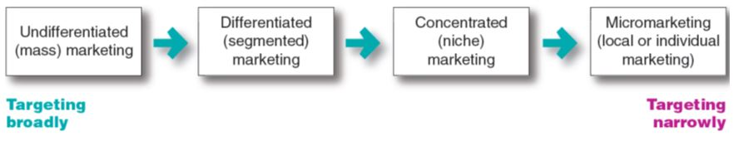
Market Targeting
Selecting Target Market Segments
Market-Targeting Strategies
Notes:
Figure 7.2 shows that companies can target very broadly (undifferentiated marketing), very narrowly (micromarketing), or somewhere in between (differentiated or concentrated marketing).
This figure covers a broad range of targeting strategies, from mass marketing (virtually no targeting) to individual marketing (customizing products and programs to individual customers). An example of individual marketing is candy lovers can buy M&M’s embossed with images of their kids or pets.

Slide 28
Market Targeting
Selecting Target Market Segments
Undifferentiated marketing targets the whole market with one offer.
Mass marketing
Focuses on common needs rather than what’s different
Can you name a company that does this?
Notes:
With undifferentiated marketing (or mass marketing), the company designs a product and a marketing program that will appeal to the largest number of buyers.
As noted in the chapter, most modern marketers have strong doubts about this strategy. Difficulties arise in developing a product or brand that will satisfy all consumers. Moreover, mass marketers often have trouble competing with more-focused firms that do a better job of satisfying the needs of specific segments and niches.

Slide 29
Market Targeting
Selecting Target Market Segments
Differentiated marketing targets several different market segments and designs separate offers for each.
Goal is to achieve higher sales and stronger position
More expensive than undifferentiated marketing
Can you name a company that does this?
Notes:
P&G markets six different laundry detergent brands in the United States, which compete with each other on supermarket shelves. Then, P&G further segments each brand to serve even narrower niches.
Developing a stronger position within several segments creates more total sales than undifferentiated marketing across all segments. Hallmark’s differentiated brands account for more than 44 percent of the greeting cards purchased in the United States. Similarly, P&G’s multiple detergent brands capture four times the market share of its nearest rival.
Differentiated marketing increases the costs of doing business. The company must weigh increased sales against increased costs when deciding on a differentiated marketing strategy.

Slide 30
Market Targeting
Selecting Target Market Segments
Concentrated marketing targets a large part of a
smaller market.
Limited company resources
Knowledge of the market
More effective and efficient
Can you name a company that does this?
Notes:
Concentrated marketing: Thanks to the reach and power of online marketing, online women’s clothing nicher ModCloth.com has attracted a devoted following. . Modcloth.com’s has a unique selection of indie clothing, engaging promotions on the ModLife blog and various social media, and Web interactivity.
When using a concentrated marketing (or niche marketing) strategy, a firm goes after a large share of one or a few smaller segments or niches. For example, Whole Foods Market thrives by catering to affluent customers that the Walmarts of the world can’t serve well.
Today, the low cost of setting up shop on the Internet makes it even more profitable to serve seemingly miniscule niches. Small businesses, in particular, are realizing riches from serving small niches on the Web.
Concentrated marketing can be highly profitable. At the same time, it involves higher-than-normal risks. Companies that rely on one or a few segments for all of their business will suffer greatly if the segment turns sour. Or larger competitors may decide to enter the same segment with greater resources. For these reasons, many companies prefer to diversify in several market segments. In fact, many large companies develop or acquire niche brands of their own.

Slide 31
Market Targeting
Selecting Target Market Segments
Micromarketing is the practice of tailoring products and marketing programs to suit the tastes of specific individuals and locations.
Local marketing
Individual marketing
Can you name a company that does this?
Notes:
Rather than seeing a customer in every individual, micromarketers see the individual in every customer. Micromarketing includes local marketing and individual marketing described on the next slides.

Slide 32
Market Targeting
Selecting Target Market Segments
Local marketing involves tailoring brands and promotion to the needs and wants of local customer segments.
Cities
Neighborhoods
Stores
Can you name a company that does this?
Notes:
Local marketing involves tailoring brands and promotions to the needs and wants of local customer groups—cities, neighborhoods, and even specific stores. For example, department store chain Macy’s has rolled out a localization program called My Macy’s in which merchandise is customized under 69 different geographical districts.
Advances in communications technology have given rise to new high-tech versions of location-based marketing. Thanks to the explosion in net-connected
smartphones with GPS capabilities and location-based social networks, companies can now track consumers’ whereabouts closely and gear their offers accordingly.
Increasingly, location-based marketing is going mobile, reaching on-the-go consumers as they come and go in key local market areas.
Discussion Question
What are the drawbacks of local marketing?
Local marketing has some drawbacks. It can drive up manufacturing and marketing costs by reducing the economies of scale. It can also create logistics problems as companies try to meet the varied requirements of different regional and local markets. Still, as companies face increasingly fragmented markets, and as new supporting technologies develop, the advantages of local marketing often outweigh the drawbacks. In addition, a brand’s overall image might be diluted if the product and message vary too much in different localities.

Slide 33
Market Targeting
Selecting Target Market Segments
Individual marketing involves tailoring products and marketing programs to the needs and preferences of individual customers.
Also known as:
One-to-one marketing
Mass customization
Notes:
Individual marketing: The PUMA Factory sneaker customization web site lets customers tailor their PUMA shoes to taste. “You know what works—what
styles, what textures, what colors. Customize your sneakers whatever way you want.”
In the extreme, micromarketing becomes individual marketing— one-to-one or markets-of-one marketing.
More detailed databases, robotic production and flexible manufacturing, and interactive media such as mobile phones and the Internet have combined to foster mass customization. Mass customization is the process by which firms interact one-to-one with masses of customers to design products and services tailor-made to individual needs. Individual marketing has made relationships with customers more important than ever.
The world appears to be coming full circle—from the good old days when customers were treated as individuals to mass marketing when nobody knew your name and then back again.

Slide 34
Market Targeting
Selecting Target Market Segments
Choosing a targeting strategy depends on
Company resources
Product variability
Product life-cycle stage
Market variability
Competitor’s marketing strategies
Notes:
As shown in the slide, companies need to consider many factors when choosing a market-targeting strategy.
When the firm’s resources are limited, concentrated marketing makes the most sense. Undifferentiated marketing is more suited for uniform products, such as grapefruit or steel.
When a firm introduces a new product, it may be practical to launch one version only, as undifferentiated marketing or concentrated marketing may make the most sense. In the mature stage of the product life cycle, however, differentiated marketing often makes more sense.
Undifferentiated marketing is appropriate where there is little market variability - most buyers have the same tastes, buy the same amounts, and react the same way to marketing efforts.
When competitors use undifferentiated marketing, a firm can gain an advantage by using differentiated or concentrated marketing, focusing on the needs of buyers in specific segments.

Slide 35
Group Work
For your companies, discuss your:
Segmentation strategy from the first half of class
Which 1-2 target markets seem to be the most attractive for your business AND which Marketing Strategy will you use?

Slide 36
Intern Work
Ask the folks facilitating your internship whether you were right about how they segment the market and if your target market was on point

